Slide 1












OPERATORS & Decision MAKING IN JAVA
“Learn how to use Java's operators and decision-making statements for efficient and effective code”

Slide 2
TABLE OF CONTENTS
01
02
INTRODUCTION
OPERATORS
03
04
DECISION MAKING STATEMENTS
REAL WORLD EXAMPLES

Slide 3


INTRODUCTION
01
Operators are symbols that are used to perform operations on variables and values. They are essential for performing mathematical calculations and logical operations in Java. Decision-making statements, on the other hand, are used to evaluate certain conditions and execute a specific block of code based on the outcome. These statements are important for controlling the flow of a program and making it more dynamic.

Slide 4


02 OPERATORS
Operators are the symbols or words used in Java to perform operations on variables and values. Java provides a rich set of operators that can be used to perform various types of operations on data. Operators in Java can be categorized into the following types:
Unary Operators
Arithmetic Operators
Assignment Operators
Logical Operators
Shift Operators
Bitwise Operators
Ternary Operators
Relational Operators

Slide 5
Let us see each operator one by one in detail.
Unary Operator
Unary operator requires only a single operand; this operator is used to increment or decrement the value, negating an expression or inverting a Boolean value.
Operator | Description
++ (Increment) | This operator is used to increment the value by 1. There are two types of increment, i.e., post-increment (a++) and pre-increment (++a)
— (Decrement). | This operator is used to decrement the value by 1. There are two types of decrement, i.e., post decrement (a–) and pre decrement (–a)
! (Invert) | This operator is used to invert a Boolean value (!a).

Slide 6
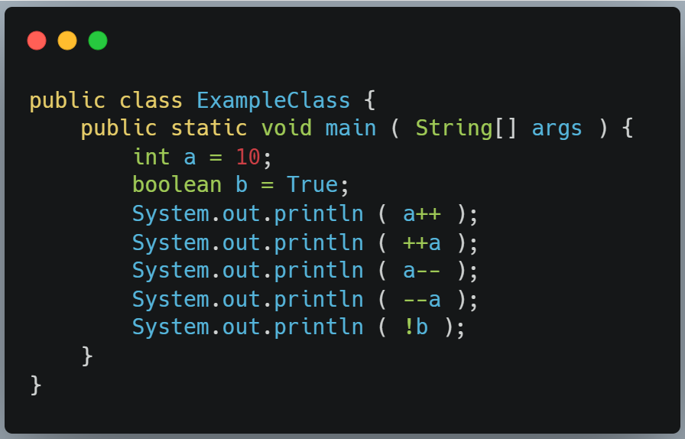
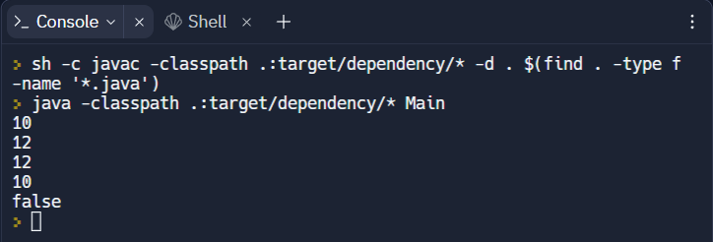
EXAMPLE

Slide 7
Arithmetic Operator
Arithmetic operators are used to performing addition, subtraction, multiplication, division, and modulus. It acts as a mathematical operations.
Operator | Description
+ ( Addition ) | This operator is used to add the value of the operands.
– ( Subtraction ) | This operator is used to subtract the right-hand operator with the left hand operator.
* ( Multiplication ) | This operator is used to multiply the value of the operands.
/ ( Division ) | This operator is used to divide the left hand operator with right hand operator.
% ( Modulus ) | This operator is used to divide the left hand operator with right hand operator and returns remainder.

Slide 8
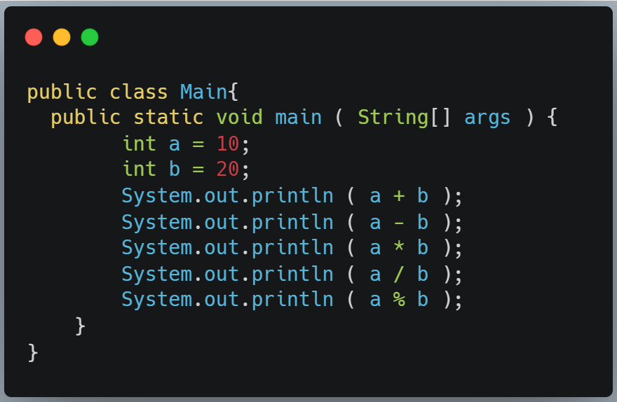
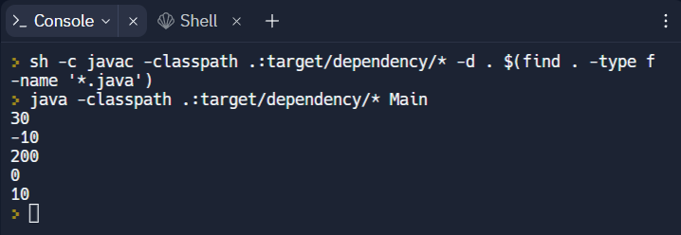
EXAMPLE

Slide 9
Assignment Operator
Assignment operator are used to assign new value to a variable. The left side operand of the assignment operator is called variable and the right side operand of the assignment operator is called value.
Operator | Description
= | This operator is used to assign the value on the right to the operand on the left.
+= | This operator is used to add right operand to the left operand and assigns the result to the left operand.
-= | This operator subtracts right operand from the left operand and assigns the result to the left operand.
*= | This operator multiplies right operand with the left operand and assigns the result to the left operand.
/= | This operator divides left operand with the right operand and assigns the result to the left operand.
^= | This operator performs exponential calculation on operators and assigns value to the left operand
%= | This operator is used to divide the left-hand operator with right hand operator and assigns the result to left operand.

Slide 10
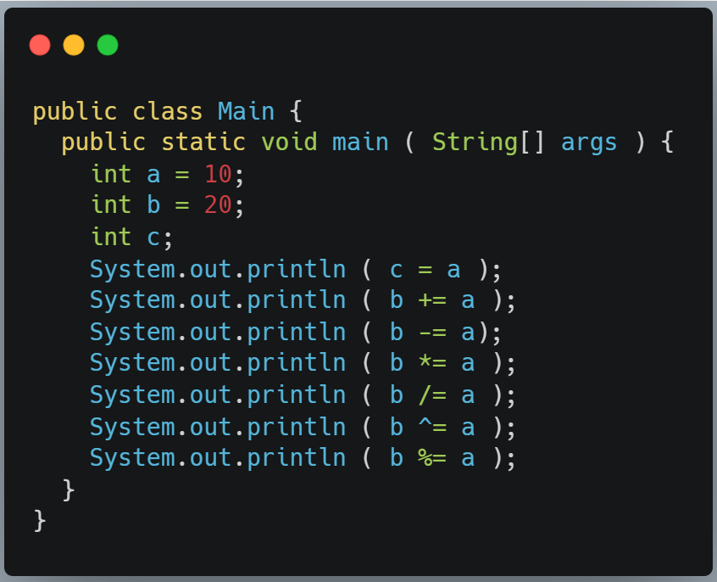
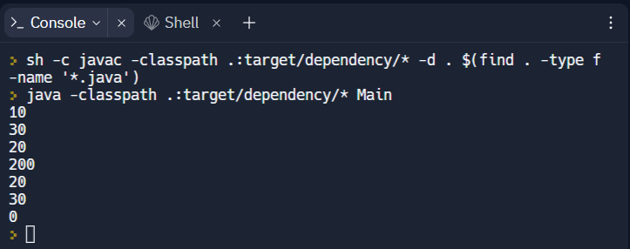
EXAMPLE

Slide 11
Logical Operator
Logical operators are used to combining two or more conditions or complement the evaluation of the original condition under consideration.
Operator | Description
&& (Logical AND) | This operator returns True if both the operands are true, otherwise, it returns False.
|| (Logical OR) | This operator returns True if either the operands are true, otherwise it returns False.
! (Logical AND) | This operator returns True if an operand is False. It reverses the logical state of an operand.

Slide 12
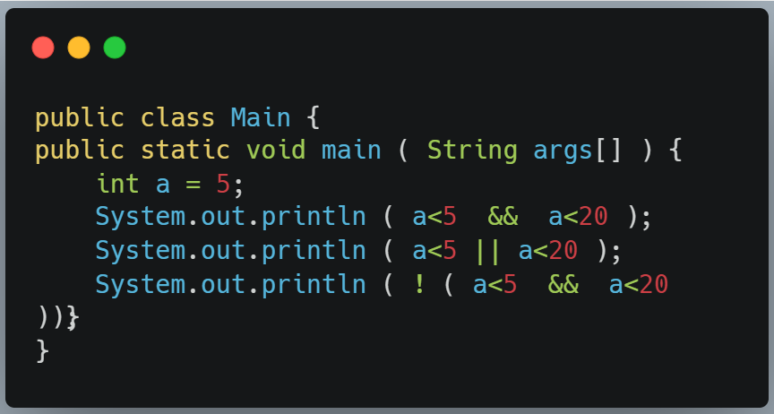
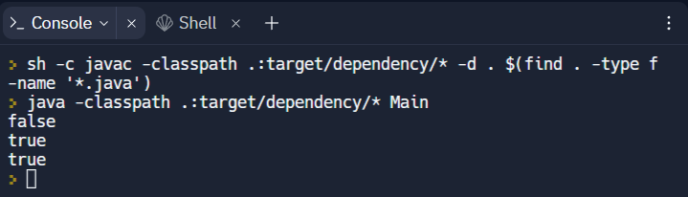
EXAMPLE

Slide 13
Shift Operator
The shift operator is used to shift the bits of a number left or right by multiplying or dividing the numbers.
Operator | Description
<< (Left Shift) | This operator left shifts the bits of the first operand; the second operand decides the number of places to shift.
>> (Right Shift) | This operator right shifts the bits of the first operand; the second operand decides the number of places to shift.

Slide 14
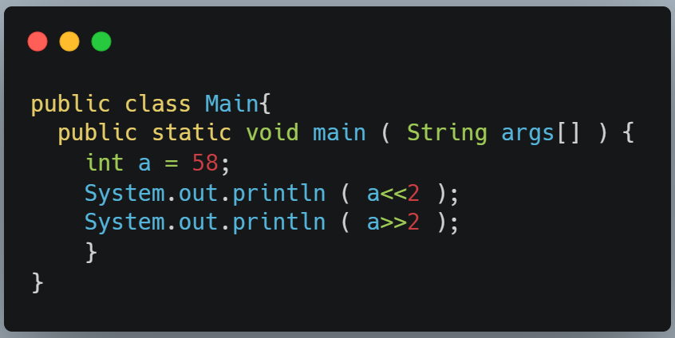
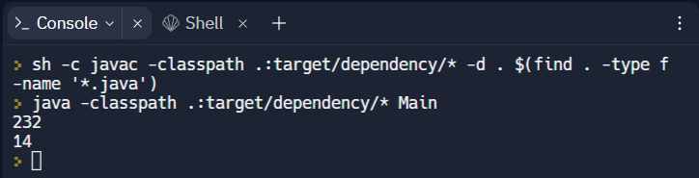
EXAMPLE

Slide 15
Bitwise Operator
The bitwise operator operates on bit string, binary number, or bit array. It is fast and simple and directly supported by the processor. The bitwise operation is also known as bit-level programming.
Operator | Description
& (Bitwise AND) | This operator takes two numbers as operands and does AND on every bit of two numbers.
| (Bitwise OR) | This operator takes two numbers as operands and does OR on every bit of two numbers.
^ (Bitwise XOR) | This operator takes two numbers as operands and does XOR on every bit of two numbers.
~ (Bitwise NOT) | This operator takes one number as an operand and does invert all bits of that number.

Slide 16
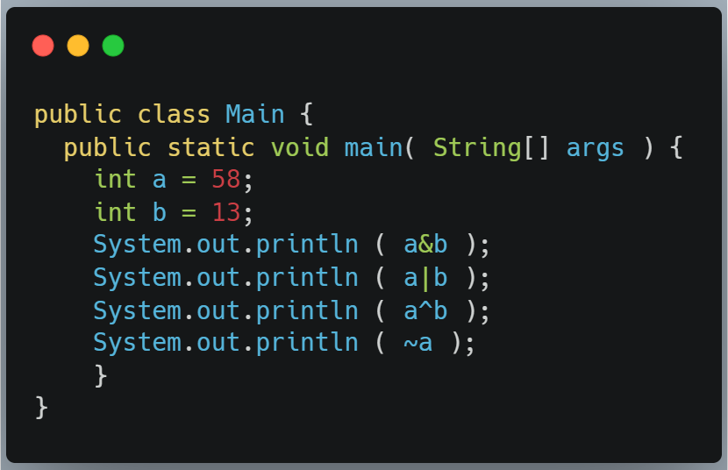
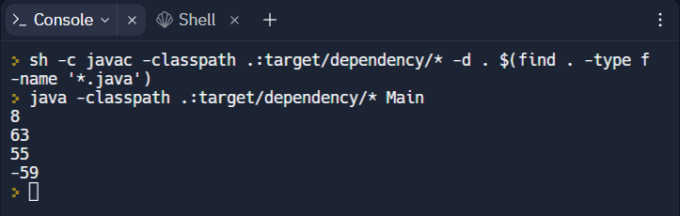
EXAMPLE

Slide 17
Ternary Operator
Ternary operator is an conditional operator, it reduces the line of code while performing the conditional or comparisons. It is the replacement of if-else or nested if-else statements. It is also referred to as inline if, conditional operator, or ternary if.
Syntax : ( Condition ) ? ( Statement1 ) : ( Statement2 );
Here Condition is the expression to be evaluated which will return the Boolean value. If the Condition result is True then Statement1 will be executed. If the Condition result is false then Statement2 will be executed.

Slide 18
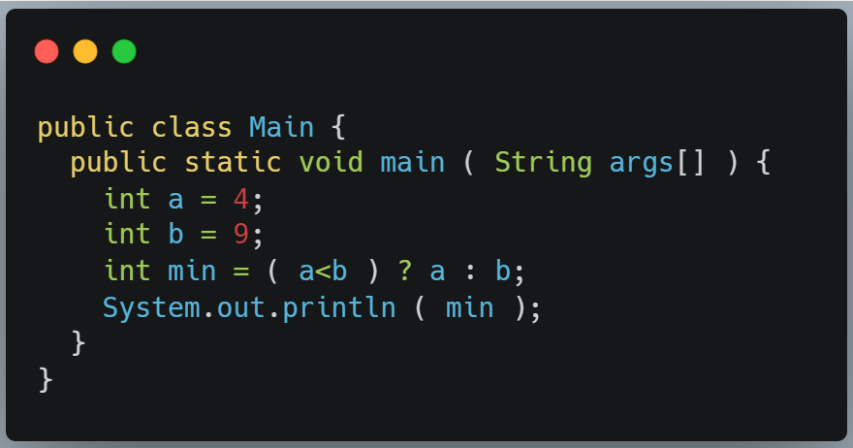
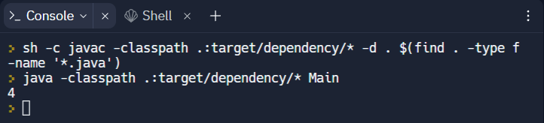
EXAMPLE

Slide 19
Relational Operator
Relational operator compares two numbers and returns a Boolean value. This operator is used to define a relation or test between two operands.
Operator | Description
< (Less than) | This operator returns True, if the value of the left operand is less than the value of the right operand, else it returns False.
> (Greater than) | This operator returns True, if the value of the left operand is greater than the value of the right operand, else it returns False.
<= (Less than or equal to) | This operator returns True, if the value of the left operand is less than or equal to the value of the right operand, else it returns False.
>= (Greater than or equal to) | This operator returns True, if the value of the left operand is greater than or equal to the value of the right operand, else it returns False.
== (Equal to) | This operator returns True, if two operands are equal, else it returns False.
!= (Not equal to) | This operator returns True, if two operands are not equal, else it returns False.

Slide 20
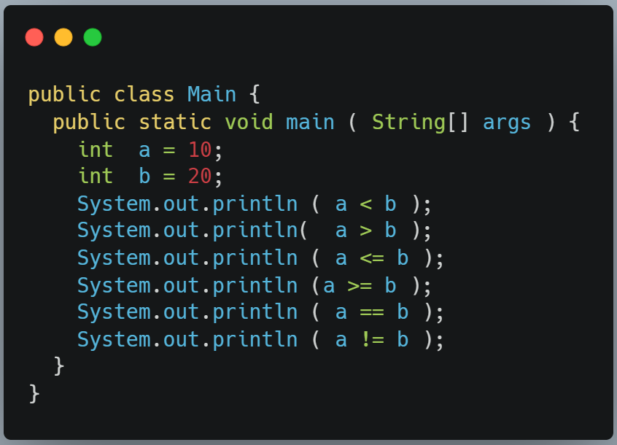
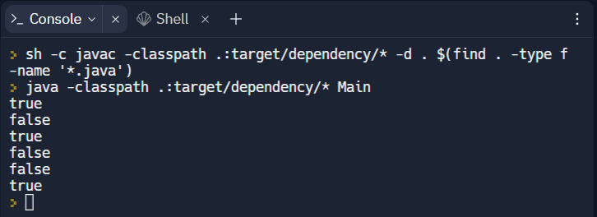
EXAMPLE

Slide 21
Java Operator Precedence and Associativity
Operator | Precedence | Associativity
Postfix | expr++ expr— | left to right
Unary | ++expr —expr +expr –expr ~ ! | right to left
Multiplicative | * / % | left to right
Additive | + – | left to right
Shift | << >> >>> | left to right
Relational | < > <= >= instanceof | left to right
Equality | == != | left to right
bitwise AND | & | left to right
bitwise exclusive OR | ^ | left to right
bitwise inclusive OR | | | left to right
logical AND | && | left to right
logical OR | || | left to right
Ternary | ? : | right to left
Assignment | = += -= *= /= %= &= ^= |= <<= >>= >>>= | right to left
Operator Precedence : Operator precedence determines which operator is performed first in an expression if there is more than one operators with different precedence.
Operator Associativity : Operator associativity is used when an expression have two operators having same precedence.

Slide 22

03 DECISION MAKING STATEMNETS
Decision making means the action of taking decisions and choosing the action plan accordingly.
Consider a real life example, you are driving a car on a road to a concert, and you see your fuel light flashing, you immediately decide that you will stop at the next petrol pump. But if the light would not have blinked at all, you would have continued driving. Right? That is where you took a decision and planned your action.

Slide 23
Decision-making statements allow the program to execute certain statements based on a certain condition.
Decision making in Java is divided into the following categories:
Selection statements
allow to choose different paths of execution.
Jump statements
enables a program to execute in a nonlinear fashion.

Slide 24
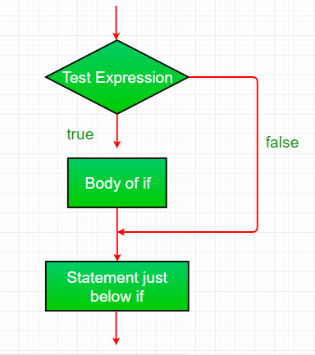
SELECTION STATEMENTS
Java supports two types of selection statements: if and switch. These statements allow us to regulate the flow of our program’s execution.
If Statement
if statement is the most simple decision-making statement. It is used to decide whether a certain statement or block of statements will be executed or not i.e. if a certain condition is true then a block of statements is executed otherwise not.
Syntax:
if(condition) {
// Statements to execute if // condition is true
}

Slide 25
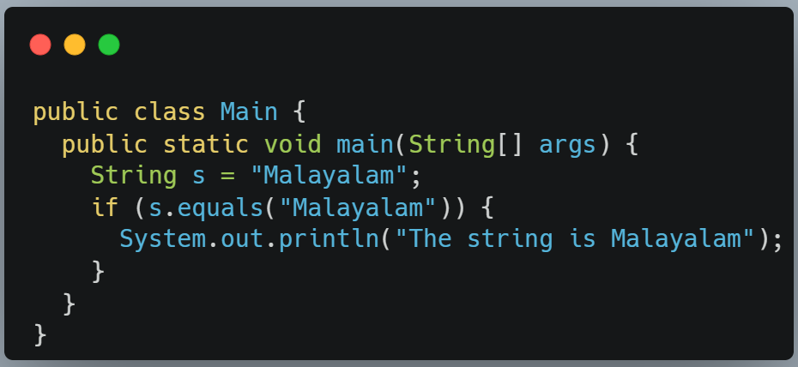
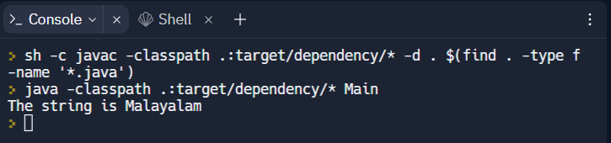
If Statement

Slide 26
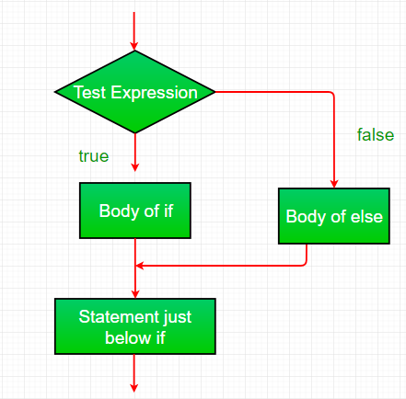
SELECTION STATEMENTS
If and else Statement
This pair of keywords is used to divide a program to be executed into two parts, one being the code to be executed if the condition evaluates to true and the other one to be executed if the value is false.
Syntax:
if (condition) {
// Executes this block if
// condition is true
} else {
// Executes this block if
// condition is false
}

Slide 27
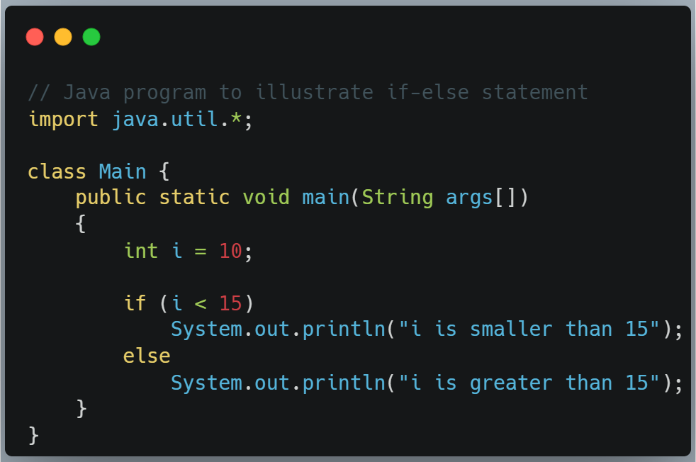
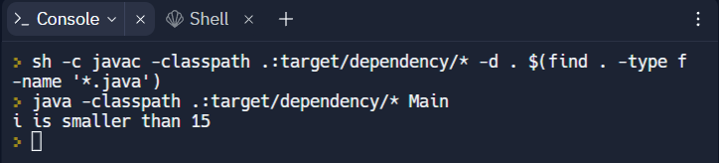
If and Else Statement

Slide 28
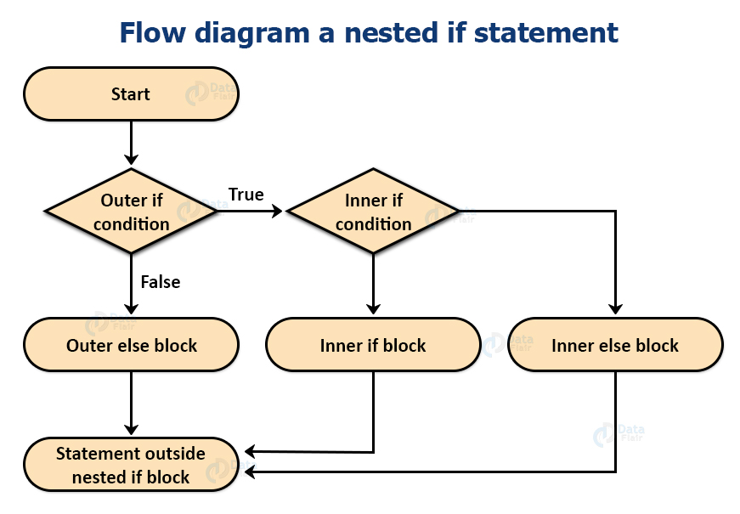
SELECTION STATEMENTS
Nested if Statements
A nested if is an if statement that is the target of another if or else. Nested if statements mean an if statement inside an if statement. Nested if’s are important if we have to declare extended conditions to a previous condition
Syntax:
if (condition1) {
// Executes when condition1 is true
if (condition2) {
// Executes when condition2 is true }
}

Slide 29
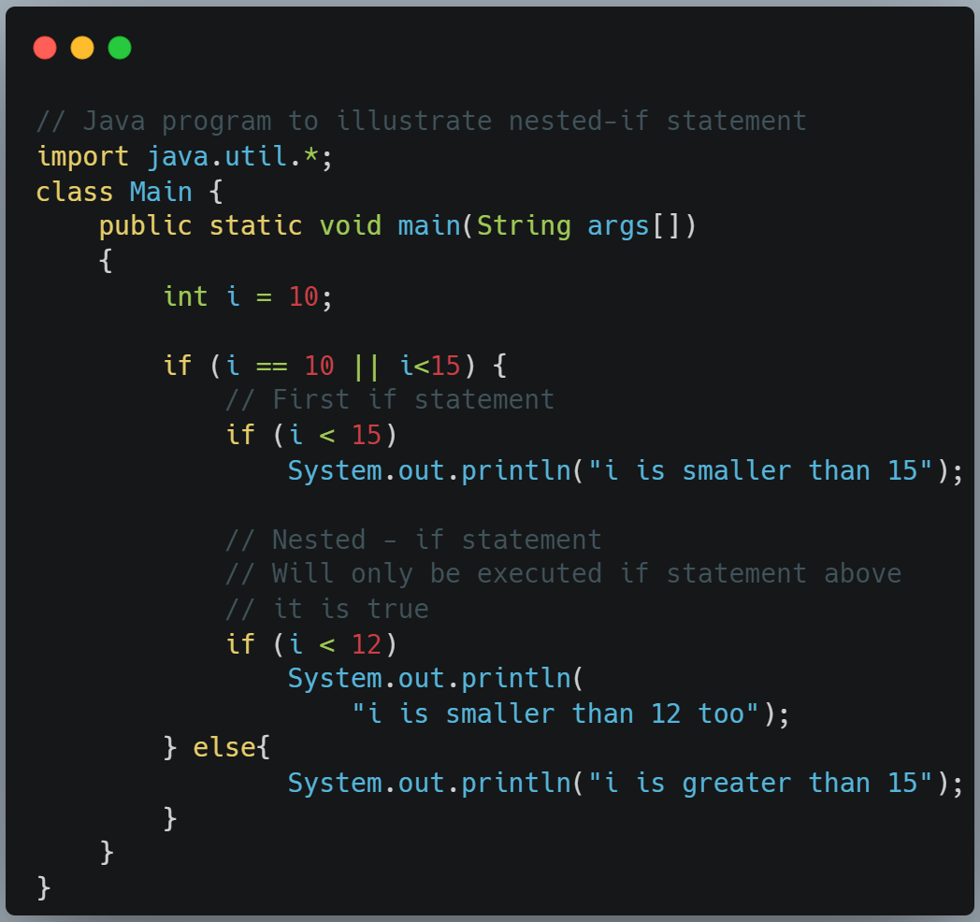
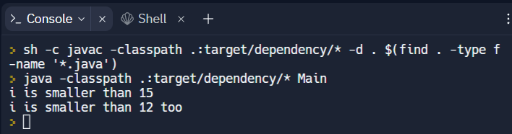
Nested if Statements

Slide 30
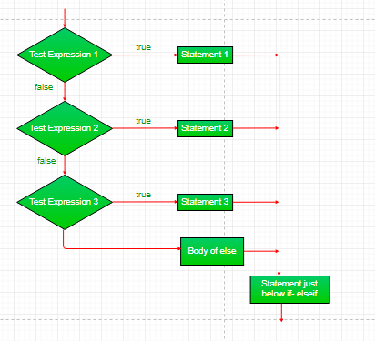
SELECTION STATEMENTS
Else-if Statements
These statements are similar to the if else statements . The only difference lies in the fact that each of the else statements can be paired with a different if condition statement. This renders the ladder as a multiple choice option for the user. As soon as one of the if conditions evaluates to true the equivalent code is executed and the rest of the ladder is ignored.
Syntax:
if (condition)
statement;
else if (condition)
statement;
. .
else
statement;

Slide 31
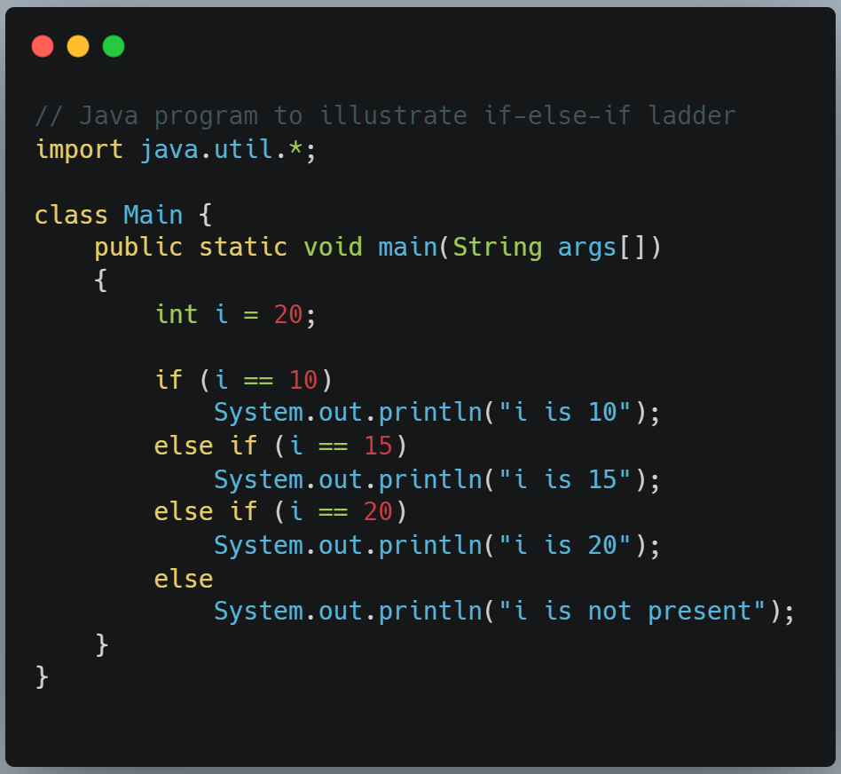
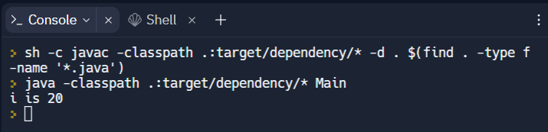
Else – if Ladder

Slide 32
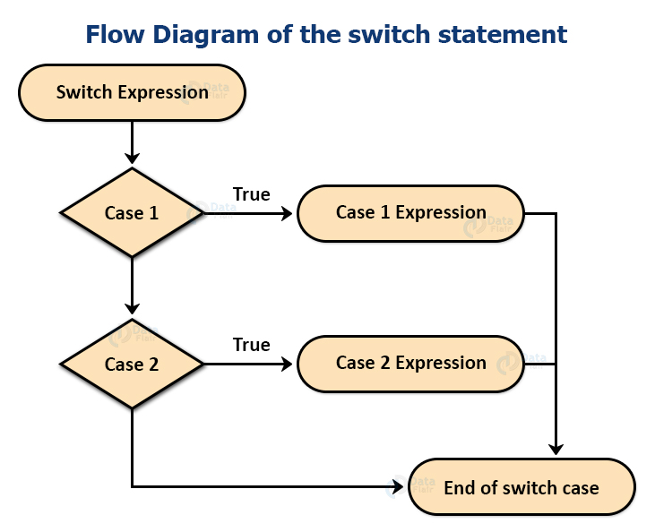
SELECTION STATEMENTS
Switch Statements
The switch statement is a multiway branch statement. It provides an easy way to dispatch execution to different parts of code based on the value of the expression.
Syntax:
switch (expression) {
case value1:
statement1;
break;
case value2:
statement2;
break;
. .
case valueN:
statementN;
break;
default:
statementDefault;
}

Slide 33
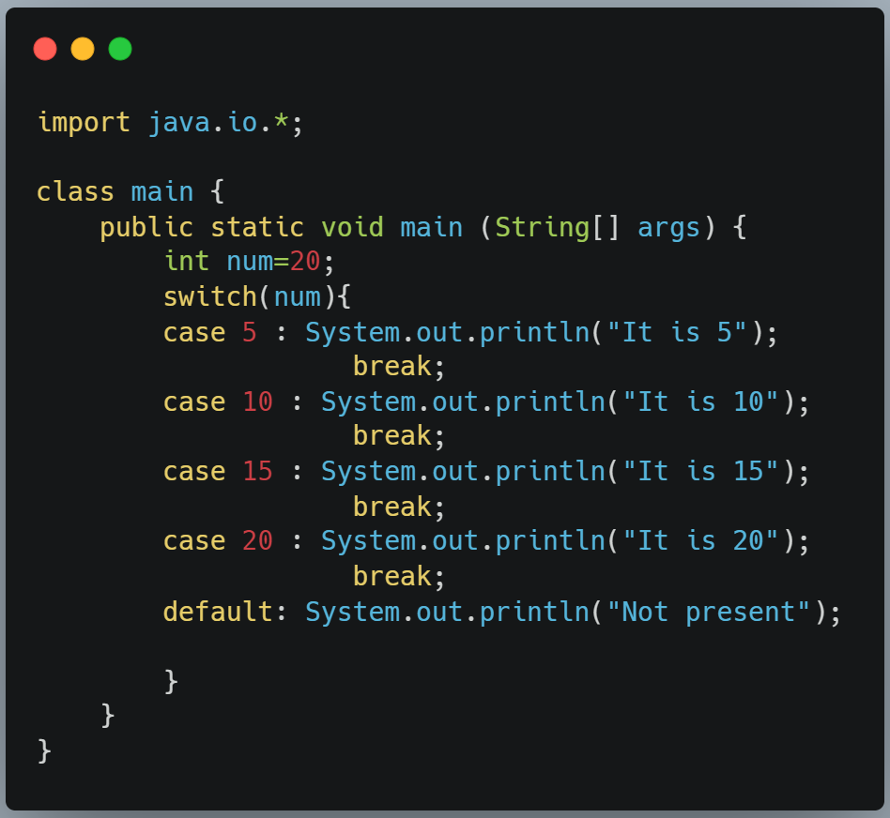
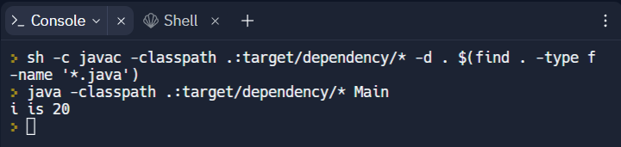
Switch Statements

Slide 34
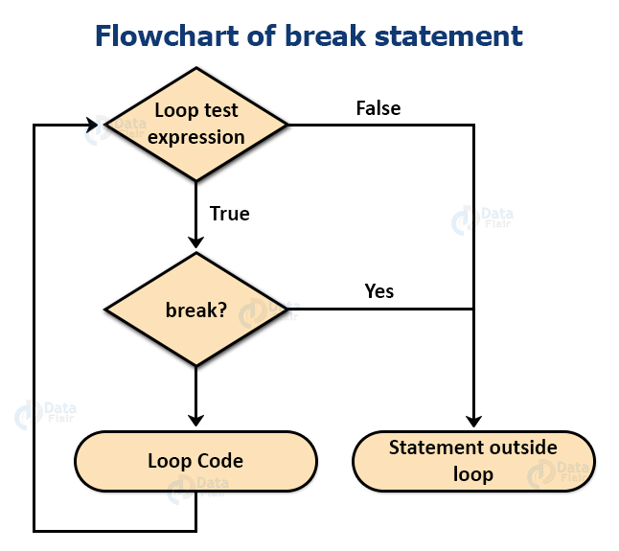
JUMP STATEMENTS
Break Statement
Terminate a sequence in a switch statement.
To exit a loop.
Used as a “civilized” form of go-to.

Slide 35
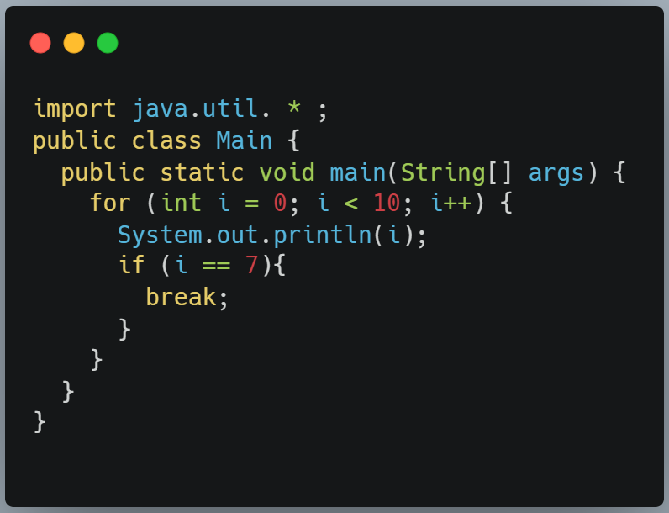
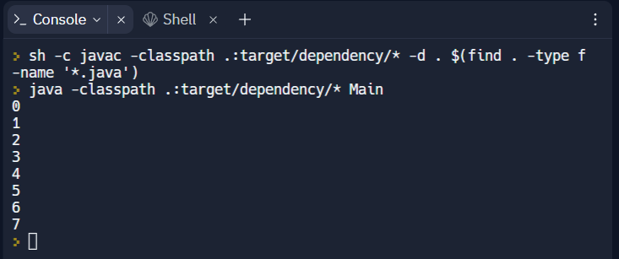
BREAK STATEMENT

Slide 36
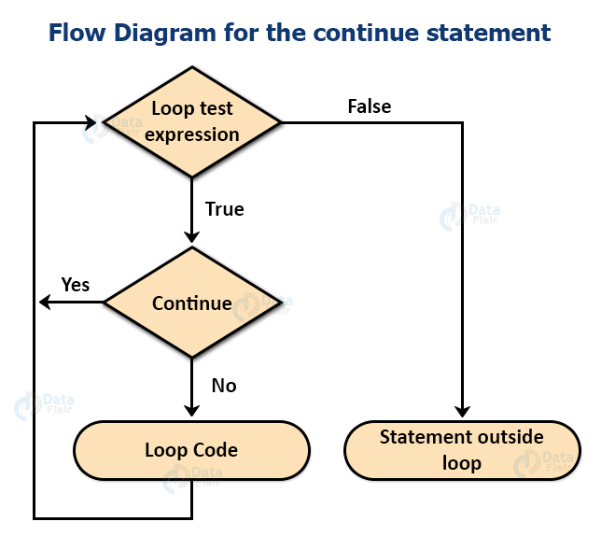
JUMP STATEMENTS
Continue Statement
The continue statement is useful for early iteration of a particular loop. Sometimes rather than breaking out of a loop and halting it for good we want to skip some iterations based on our requirements of a program. This results in the usage of continue statements.

Slide 37
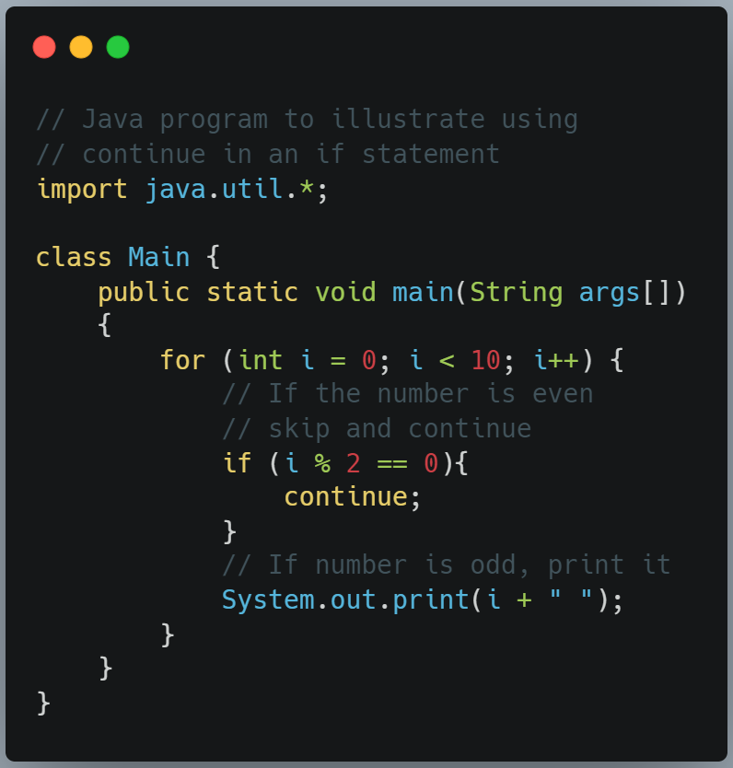
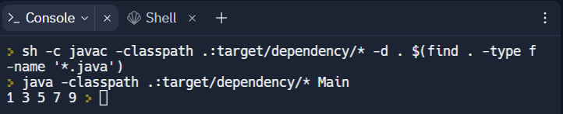
CONTINUE STATEMENT

Slide 38

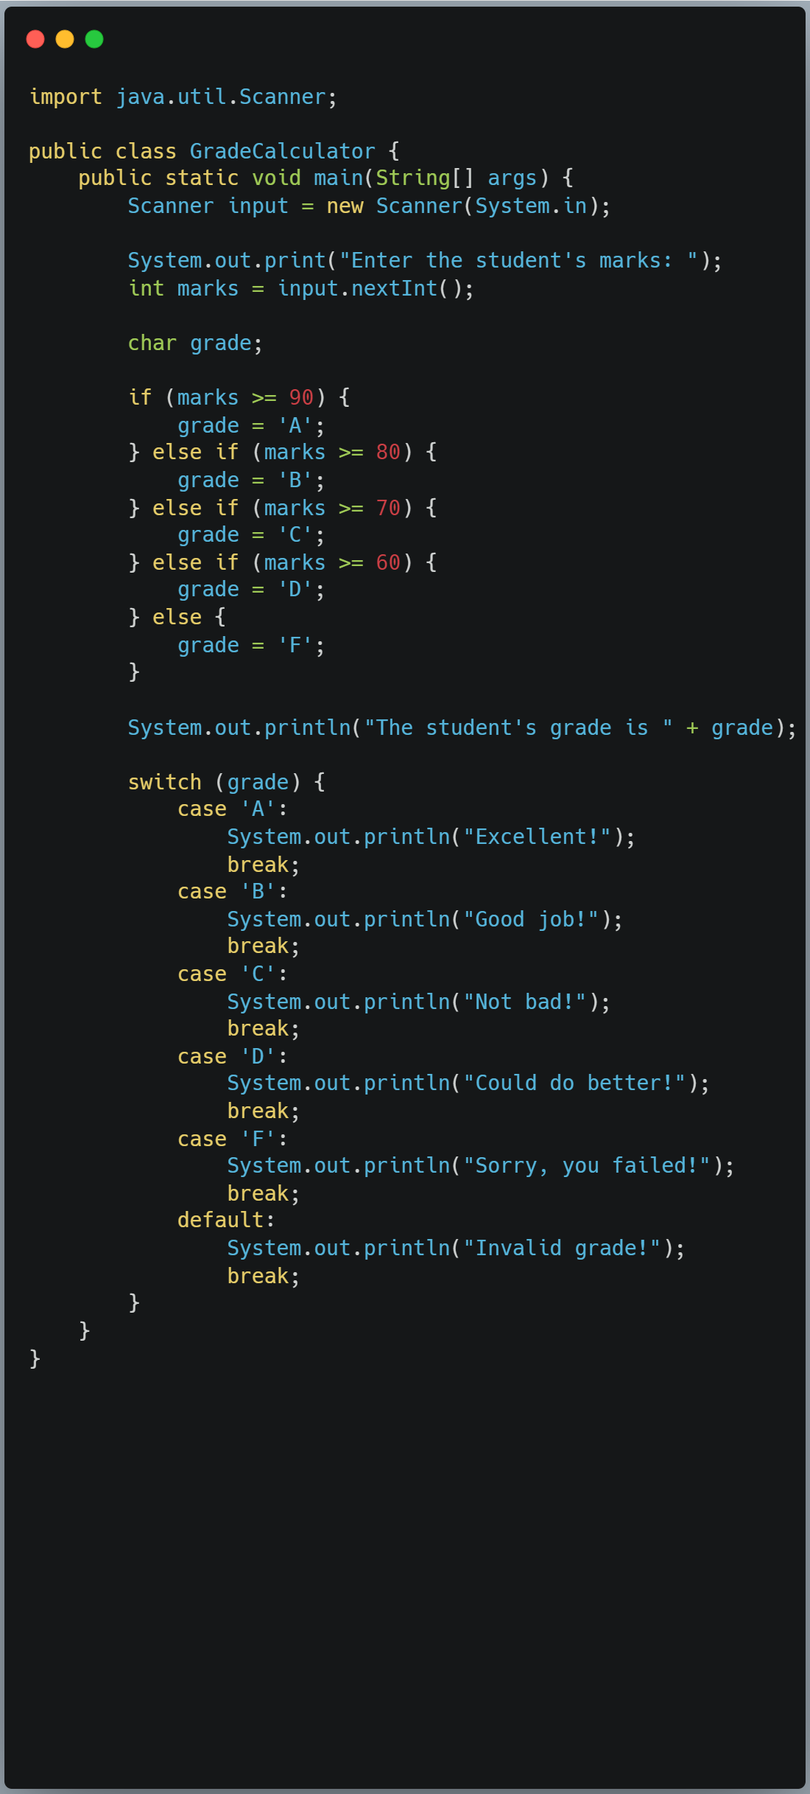

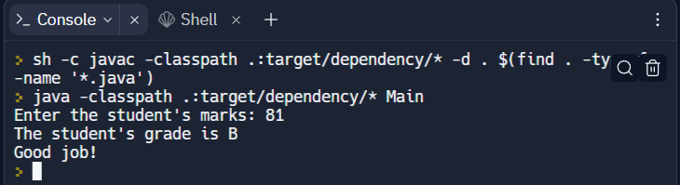
REAL WORLD EXAMPLES
Let's consider an example of a program that calculates the grade of a student based on their marks. We will use operators and decision-making statements to implement this program.

Slide 39
CONCLUSION
Operators and decision-making statements are used in various real-world scenarios. For example, in a banking system, decision-making statements are used to determine if a customer is eligible for a loan or not based on their credit score. In a hospital management system, operators are used to calculate the dosage of medicine based on the patient's weight and decision-making statements are used to determine the type of treatment required based on the patient's symptoms.
They are used extensively in real-world scenarios to perform calculations, make decisions, and automate processes.

Slide 40
THANKS!
Does anyone have any questions?
am400718@gmail.com
D A GURUPRIYAN
20384111

